Slide 1


Android Service
Dimitar Ivanov
Mobile Applications with Android
Telerik Software Academy
http://academy.telerik.com

Slide 2
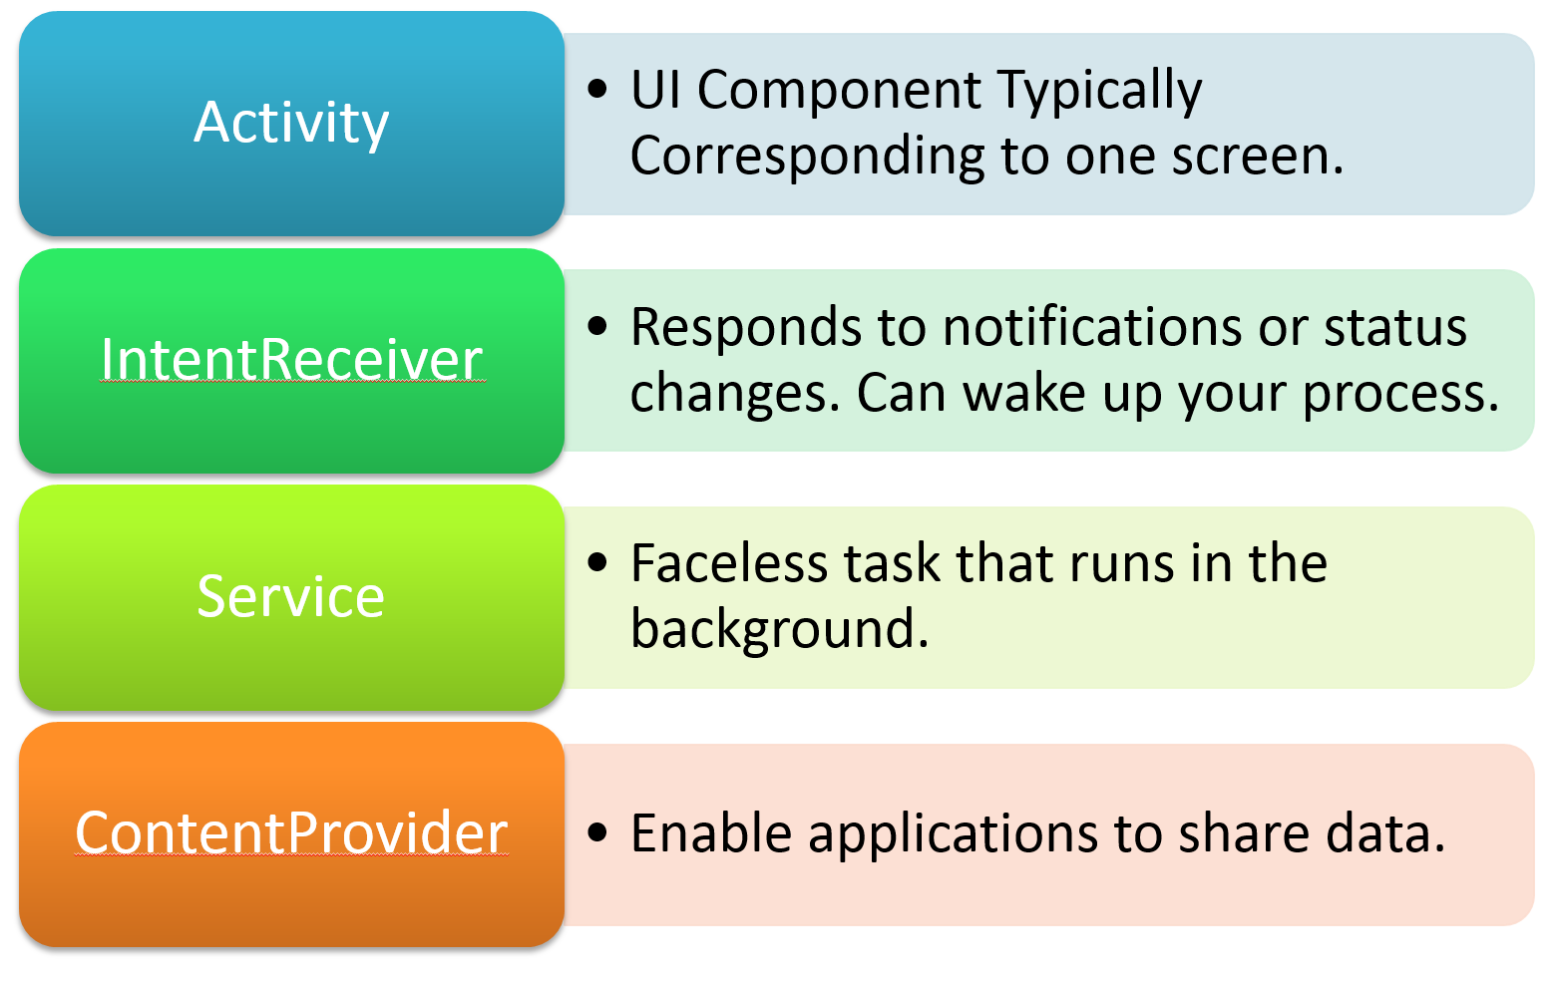
Application Building Blocks

Slide 3
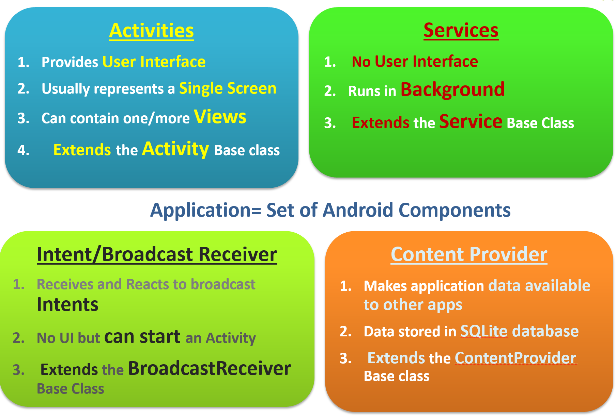
Anatomy

Slide 4
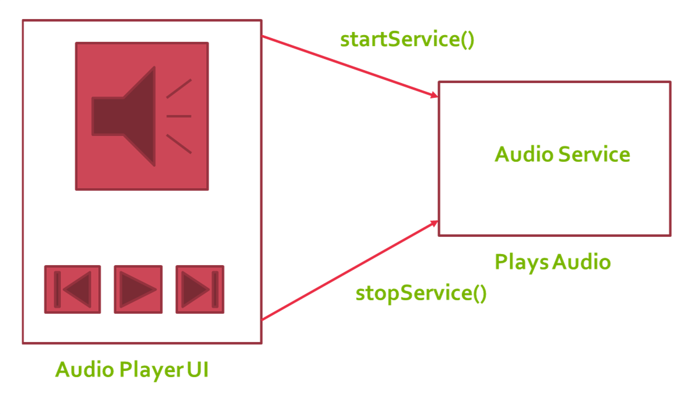
Simple Usage

Slide 5
Demo

Slide 6
Android Service
http://academy.telerik.com

Slide 7
Homework
Implement the following application

